Slide 1
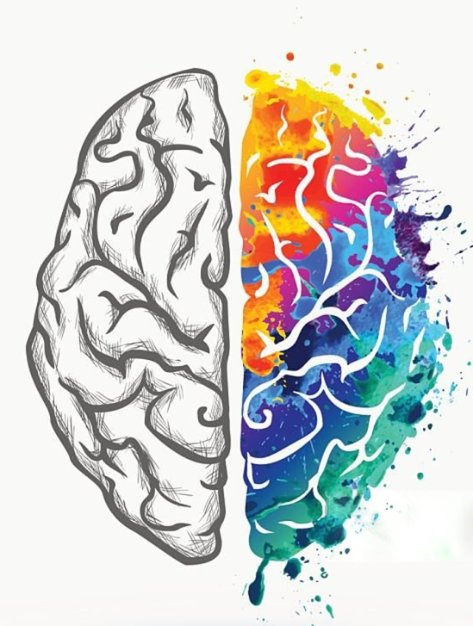
Neurotransmitters
Chad Williams
University of Victoria

Slide 2
Lecture Outline
Communication
Types of NTs
Drugs

Slide 3
Lecture Outline
Communication
Types of NTs Drugs

Slide 4
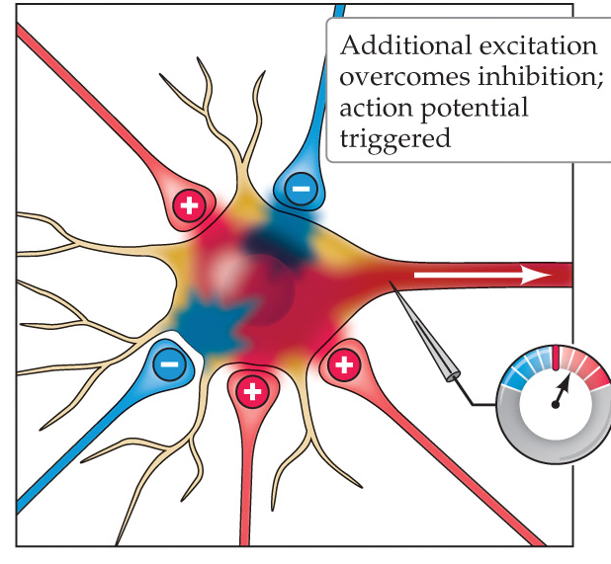
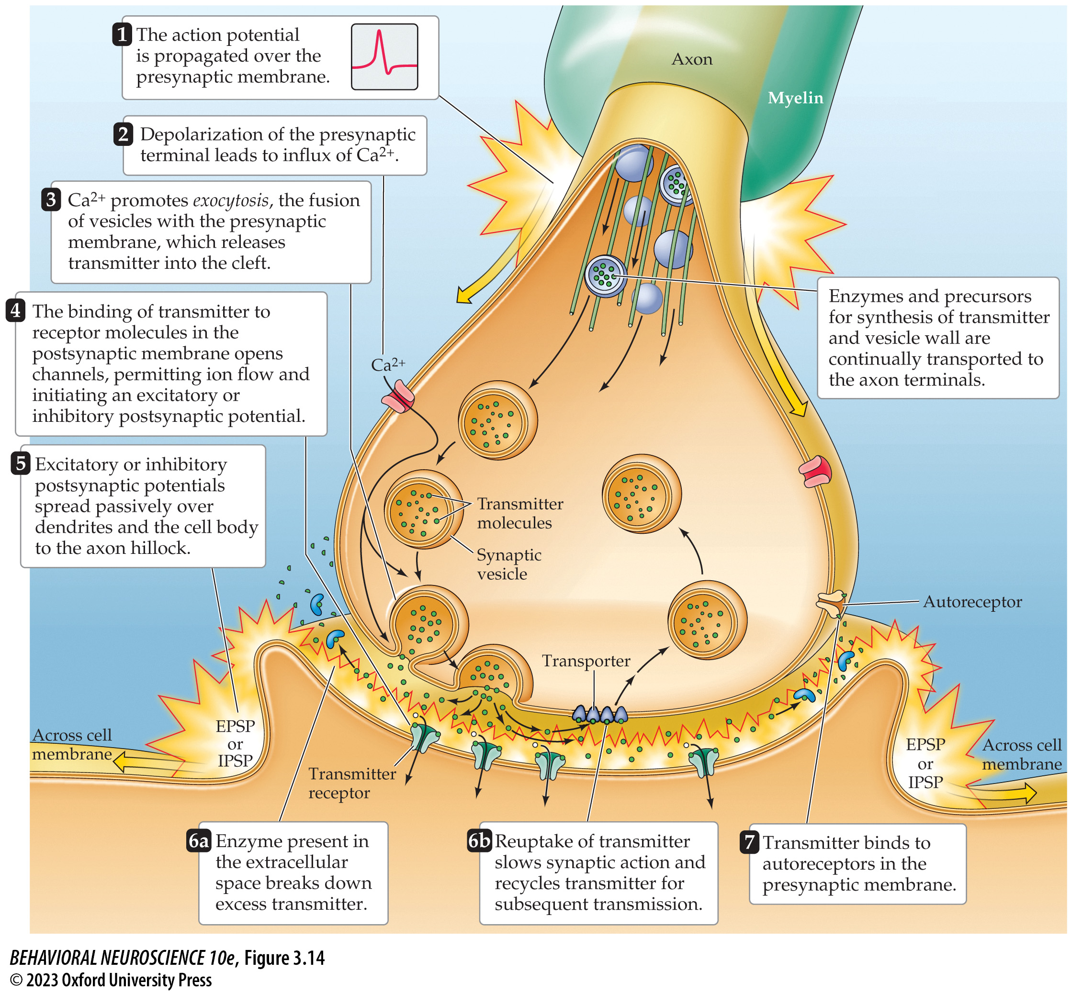
Neurotransmitters
Neurotransmitter release:
The action potential ends in the axon terminal, which triggers communication with other neurons
Action potentials result in calcium (Ca²⁺) entering the terminal
Causes Vesicles to fuse with membrane
Exocytosis: Vesicle fusing which releases neurotransmitters in the synaptic cleft

Slide 5
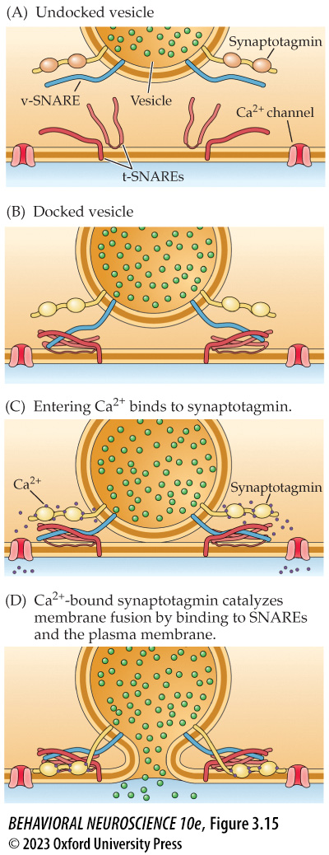
Neurotransmitters
Neurotransmitter (NT) Release
Within an axon terminal, neurotransmitters are held within vesicles
An action potential at the axon terminal results in the intake of calcium (Ca²⁺)
These calcium ions bind to synaptotagmin, which in turn bind to SNARE proteins on the membrane
This binding pulls the vesicle towards the membrane

Slide 6
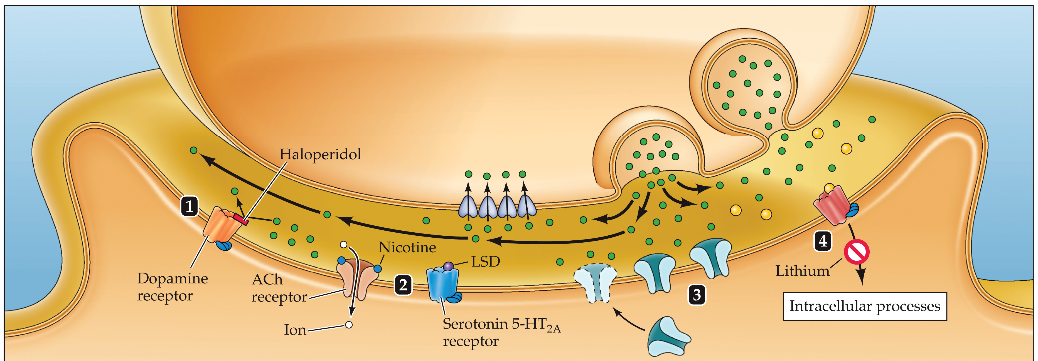
Neurotransmitters
Neurotransmitters (NT) in the Cleft
Vesicles are built as lipid bilayers, the same thing the membrane is built from, so it easily combines with the membrane, releasing the NT
NTs then float in the extracellular space (within the synaptic cleft) and may bind to receptors on the next neuron’s membrane
Binding is the communication between the first and second neuron
The same NT may cause very different responses depending on the bound receptor

Slide 7
Neurotransmitters
Neurotransmitters (NT) in the Cleft
When NTs do not bind to next neuron:
Degradation: Broken down by enzymes in the synaptic cleft
Reuptake: Absorbed by the first neuron through transporters for reuse
Repackaged into vesicles or degradation
Glial Reuptake: NTs can also be absorbed by supporting glial cells

Slide 8
Neurotransmitters
Neurotransmitters (NT) in the Cleft
When NTs do not bind to next neuron:
Autoreceptors: Receptors on the first cell used as a signal for change
Feedback Loop: Autoreceptor binding indicates too many NTs were released and can cause the first neuron to produce less in the future

Slide 9
Neurotransmitters
Neurotransmitters (NT) in the Cleft
When NTs do not bind to next neuron:
Diffusion: A small amount of NTs passively diffuse out of the synaptic cleft
But this is not a main mechanism of recycling unused neurotransmitters

Slide 10
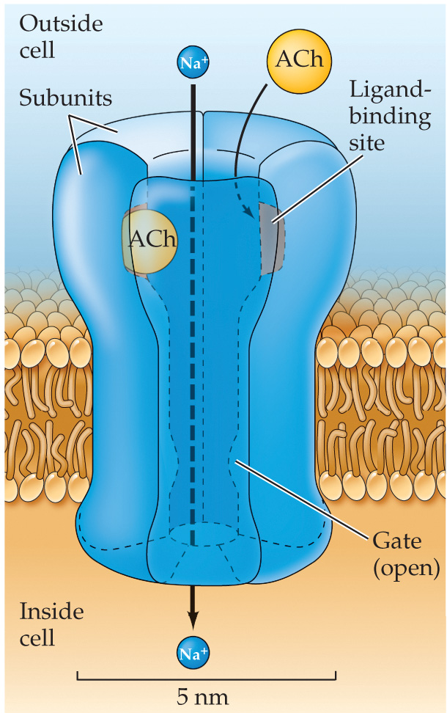
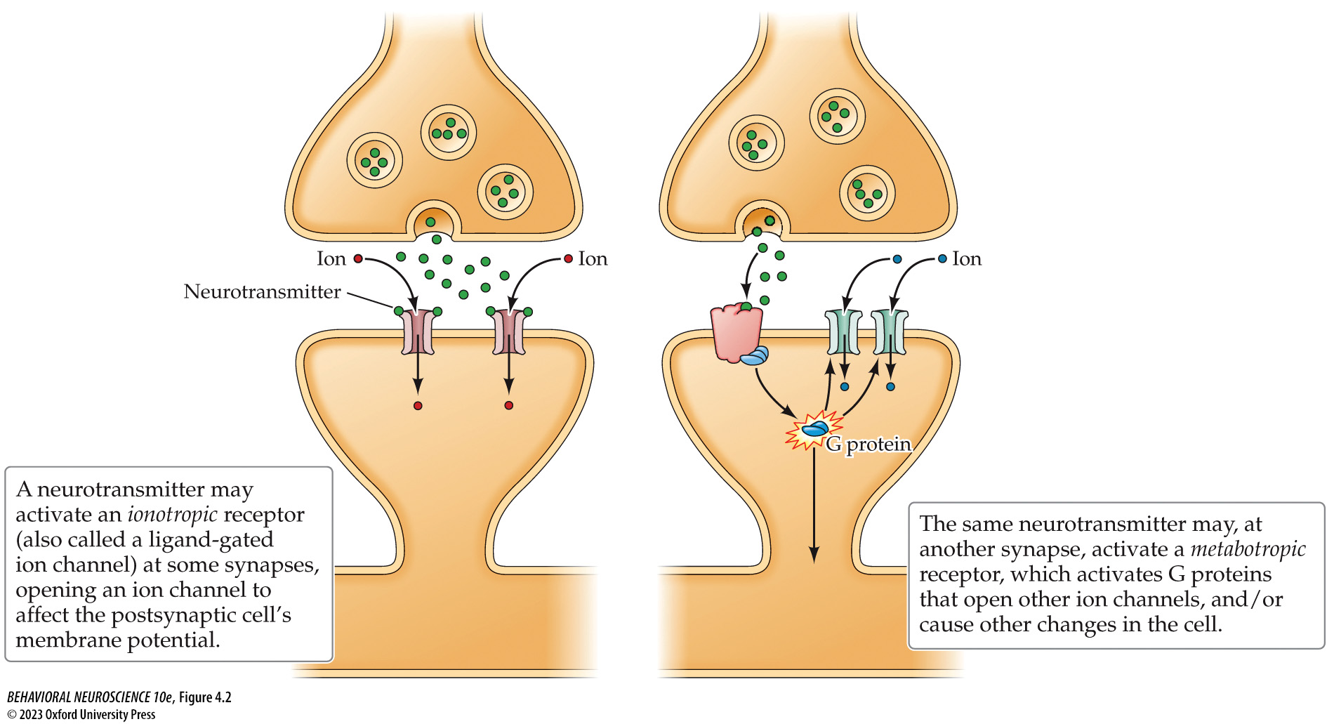
Neurotransmitters
Neurotransmitters (NT) in the Cleft
NTs may bind to:
Ionotropic Receptors: A receptor that allows ions through the membrane
Involved in changing membrane polarity to facilitate or inhibit an action potential
Fast and temporary changes

Slide 11
Neurotransmitters
Neurotransmitters (NT) in the Cleft
NTs may bind to:
Metabotropic Receptors: A receptor that begins a cascade of activity within the neuron
It does not allow anything to pass the membrane directly
Instead, it activates a G-Protein that can have diverse consequences
Slow and lasting changes
Ion channel conductance
Enzyme production
Etc.

Slide 12
Lecture Outline
Communication
Types of NTs Drugs

Slide 13
Neurotransmitters
Classification of a Neurotransmitter:
Exists in axon terminal
Neuron contains enzymes to synthesize NT
NT released in significant quantities due to an action potential
There exists post-synaptic receptors specific to the NT
Causes a change in post-synaptic cell
Blocking the NT prevents change in postsynaptic cell

Slide 14
Neurotransmitters
 | Origin | Projection | Function | Receptor
Glutamate | Across the brain | Across the brain | Major excitatory | Ionotropic & metabotropic
GABA | Across the brain | Across the brain | Major inhibitory | Ionotropic & metabotropic
Acetylcholine | Basal forebrain, brainstem | Hippocampus, amygdala, cortex | Learning, memory, attention, arousal | Ionotropic & metabotropic
Dopamine (Nigrostriatal) | Substantia nigra | Basal ganglia | Motor Control | Metabotropic
Dopamine (Mesolimbic) | Ventral tegmental area | Limbic system | Reward and reinforcement | Metabotropic
Dopamine (Mesocortical) | Ventral tegmental area | Prefrontal cortex | Executive functioning | Metabotropic
Serotonin | Raphe nuclei | Hippocampus, cerebellum, cortex | Sleep, mood, sex, anxiety | Metabotropic
Norepinephrine | Locus coeruleus | Thalamus, limbic, cerebellum, cortex | Mood, arousal, sex | Metabotropic

Slide 15
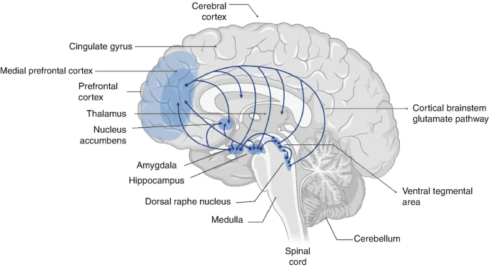
Glutamate (Glu)
Pathway
Origin: Across the brain
Projects: Across the brain
Function: Diverse, the major excitatory NT
Receptors: Ionotropic and metabotropic

Slide 16
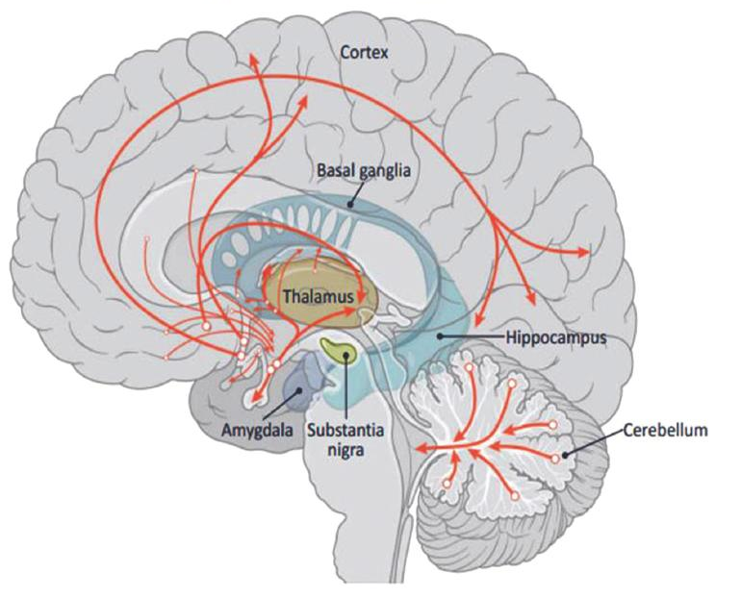
Gamma-Aminobutyric Acid (GABA)
Pathway
Origin: Across the brain
Projects: Across the brain
Function: Diverse, the major inhibitory NT
Receptors: Ionotropic and metabotropic

Slide 17
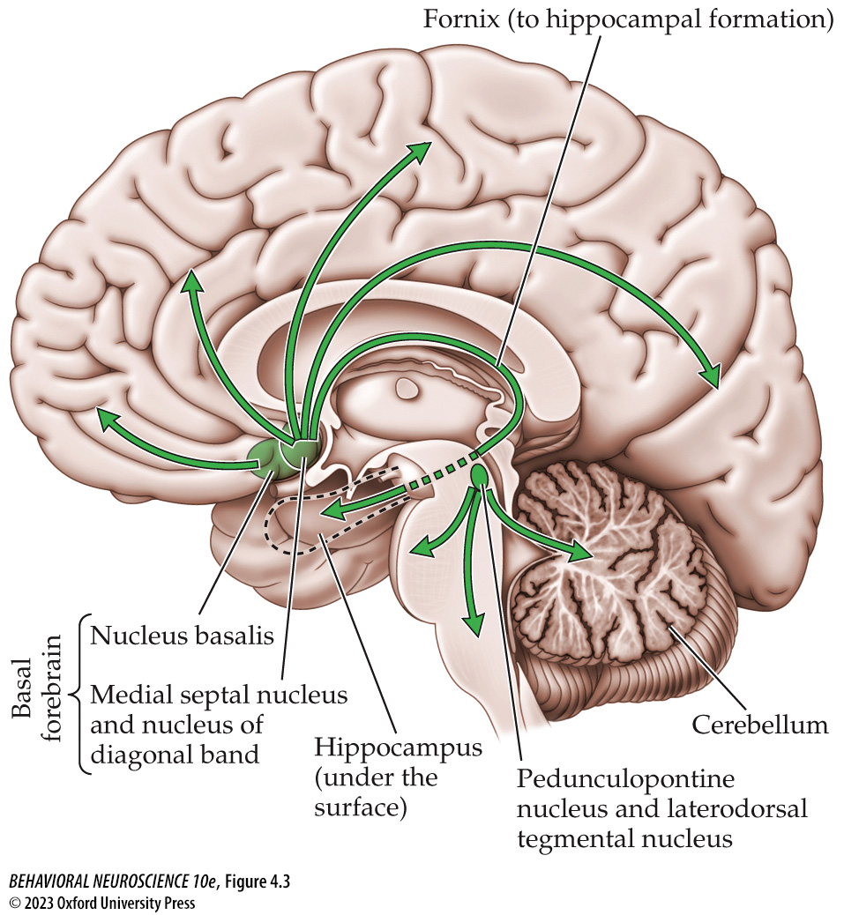
Acetylcholine (ACh)
Pathway
Origin: Basal forebrain + brainstem
Projects: Hippocampus, amygdala, and cortex
+ widely across the brain
Function: Learning, memory, attention, arousal
Receptors: Ionotropic and metabotropic

Slide 18
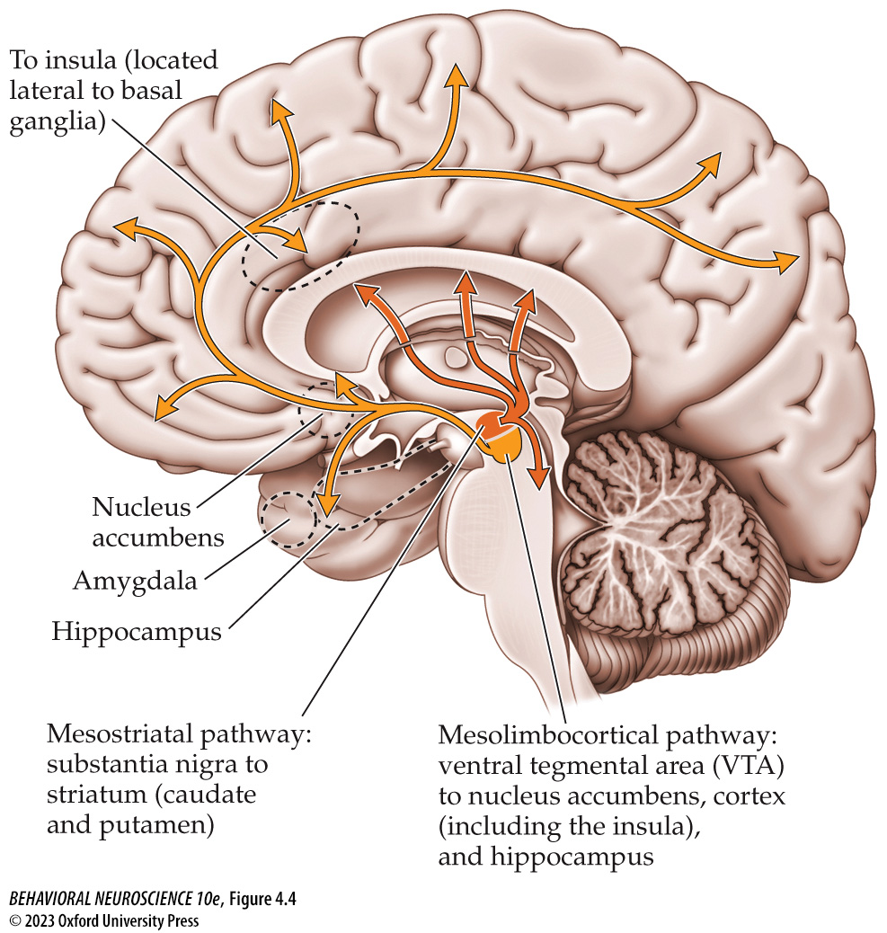
Dopamine (DA)
Nigrostriatal (Mesostriatal):
Pathway
Origin: Substantia Nigra
Projects: Basal ganglia
Function: Motor control
Receptors: Metabotropic

Slide 19
Dopamine (DA)
Mesolimbic:
Pathway
Origin: Ventral tegmental area
Projects: Limbic system
Function: Reward and reinforcement
Receptors: Metabotropic

Slide 20
Dopamine (DA)
Mesocortical:
Pathway
Origin: Ventral tegmental area
Projects: Prefrontal cortex
Function: Executive functioning
Receptors: Metabotropic

Slide 21
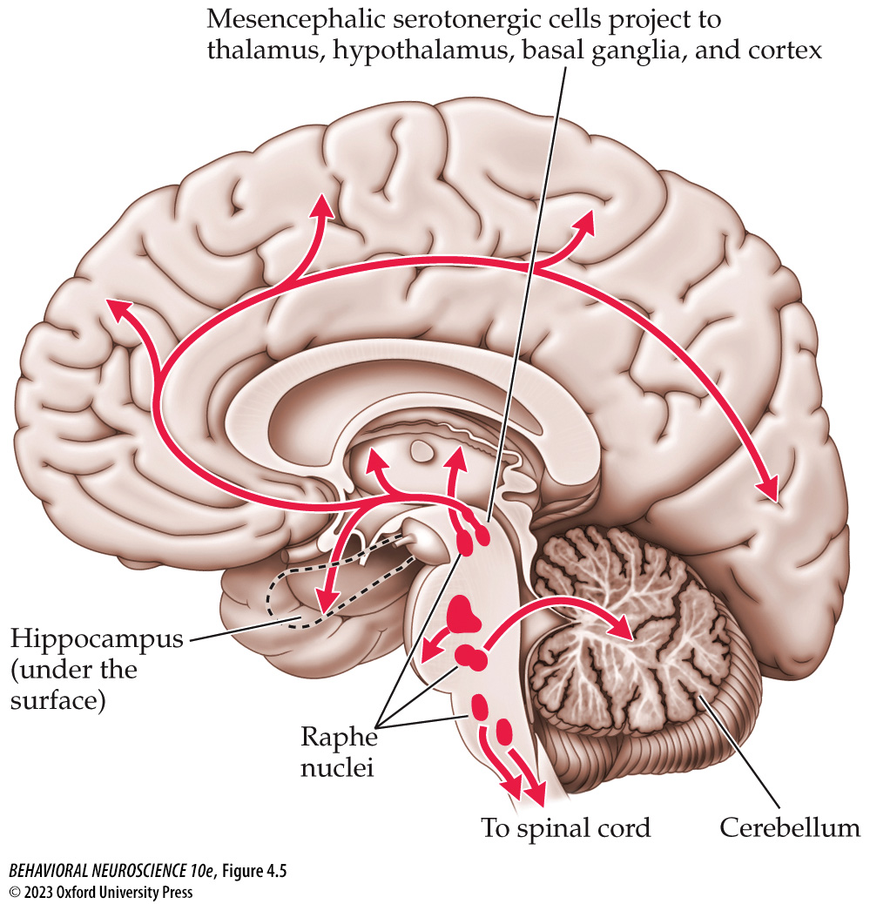
Serotonin (5-HT)
Pathway
Origin: Raphe nuclei
Projects: Hippocampus, cerebellum
+ widely across the brain
Function: Sleep, mood, sex, anxiety
Receptors: Mostly metabotropic
Very diverse with many subtypes

Slide 22
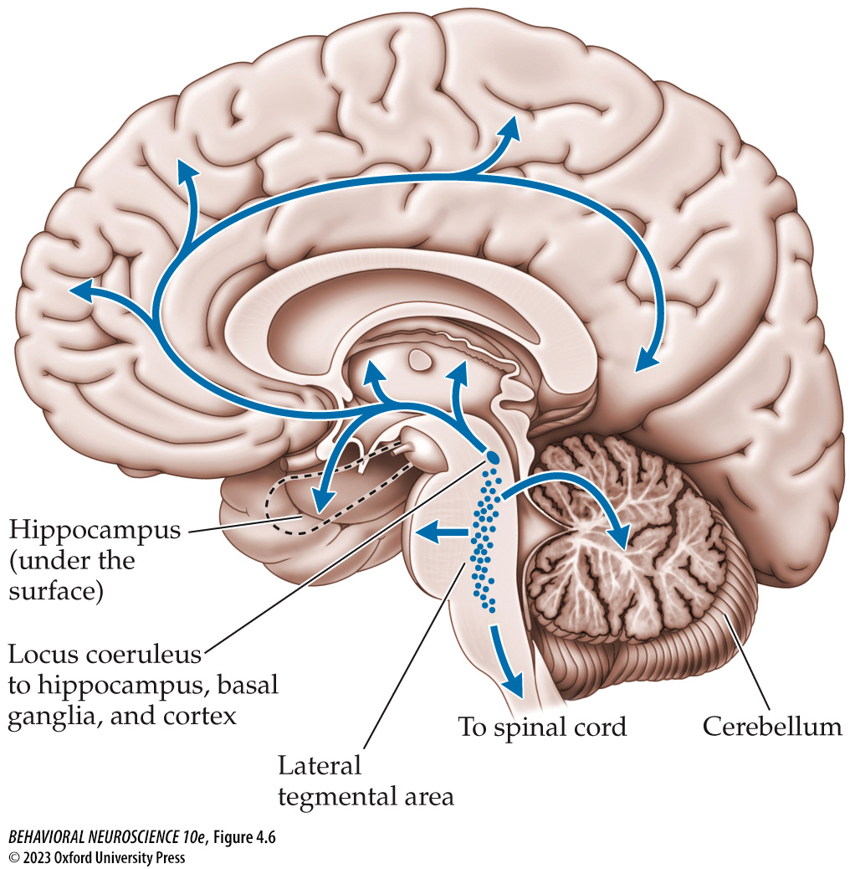
Norepinephrine (NE) / Noradrenaline (NA)
Pathway:
Origin: Locus coeruleus
Projects: Thalamus, limbic system, cortex, cerebellum
+ widely across the brain
Function: Diverse, including mood, arousal, sexual behaviour
Receptors: Metabotropic

Slide 23
Neurotransmitters
 | Origin | Projection | Function | Receptor
Glutamate | Across the brain | Across the brain | Major excitatory | Ionotropic & metabotropic
GABA | Across the brain | Across the brain | Major inhibitory | Ionotropic & metabotropic
Acetylcholine | Basal forebrain, brainstem | Hippocampus, amygdala | Learning, memory, attention, arousal | Ionotropic & metabotropic
Dopamine (Nigrostriatal) | Substantia nigra | Basal ganglia | Motor Control | Metabotropic
Dopamine (Mesolimbic) | Ventral tegmental area | Limbic system | Reward and reinforcement | Metabotropic
Dopamine (Mesocortical) | Ventral tegmental area | Prefrontal cortex | Executive functioning | Metabotropic
Serotonin | Raphe nuclei | Hippocampus, cerebellum, cortex | Sleep, mood, sex, anxiety | Metabotropic
Norepinephrine | Locus coeruleus | Thalamus, limbic, cerebellum, cortex | Mood, arousal, sex | Metabotropic

Slide 24
Lecture Outline
Communication
Types of NTs Drugs

Slide 25
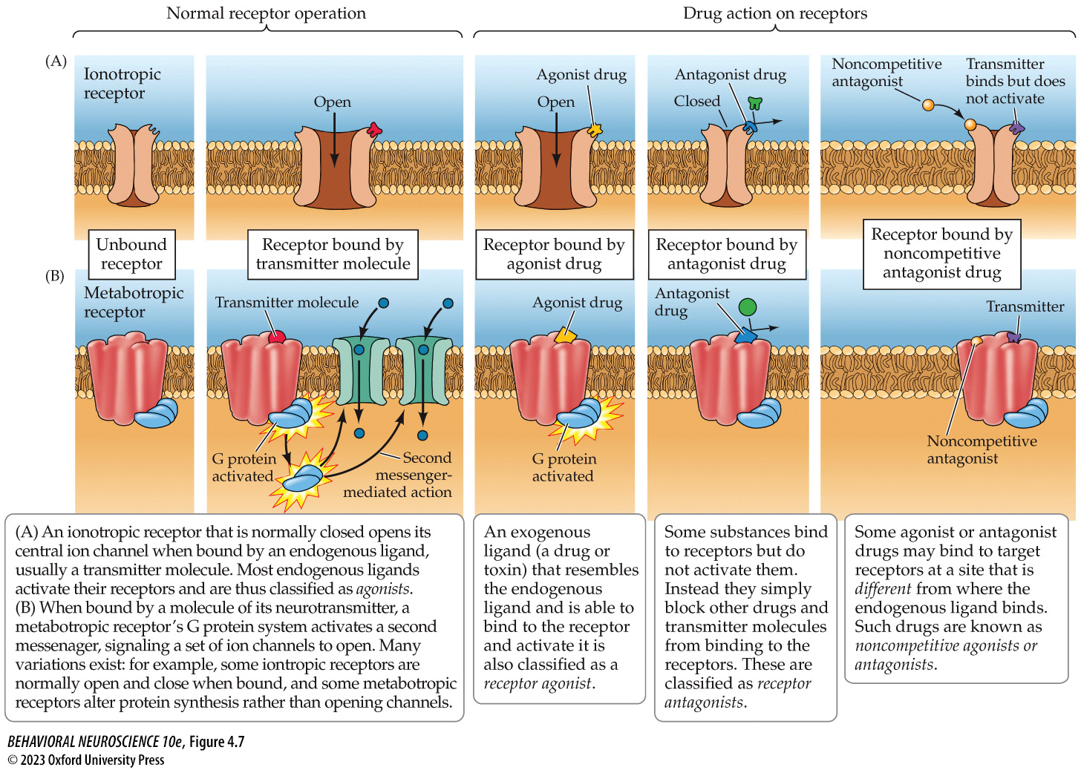
Drugs
Drugs: Substances that alter neurotransmission by modifying the effects of neurotransmitters
Can act directly by binding to receptors
Can act indirectly by altering neurotransmitter availability or signaling

Slide 26
Drugs
Direct (Receptor-Level)
Types
Agonist: Activates the receptor, producing a similar effect as the neurotransmitter
Antagonist: Blocks the receptor, preventing the neurotransmitter’s effect
Inverse Agonist: Produces the opposite effect

Slide 27
Drugs
Direct (Receptor-Level)
Binding Site
Competitive: Binds to same site as the NT
Noncompetitive: Binds to a different site than the NT

Slide 28
Drugs
Indirect (Neurotransmitter-Level)
Synthesis: Alters neurotransmitter production
Release: Alters neurotransmitter release
Reuptake Inhibition: Blocks the reuptake of neurotransmitters, leaving them in the synaptic cleft
Increases the effect of neurotransmitters (stronger and longer lasting effect)
Enzymatic Degradation Inhibition: Blocks enzymes from degrading NTs
Increases the effect of neurotransmitters (stronger and longer lasting effect)

Slide 29
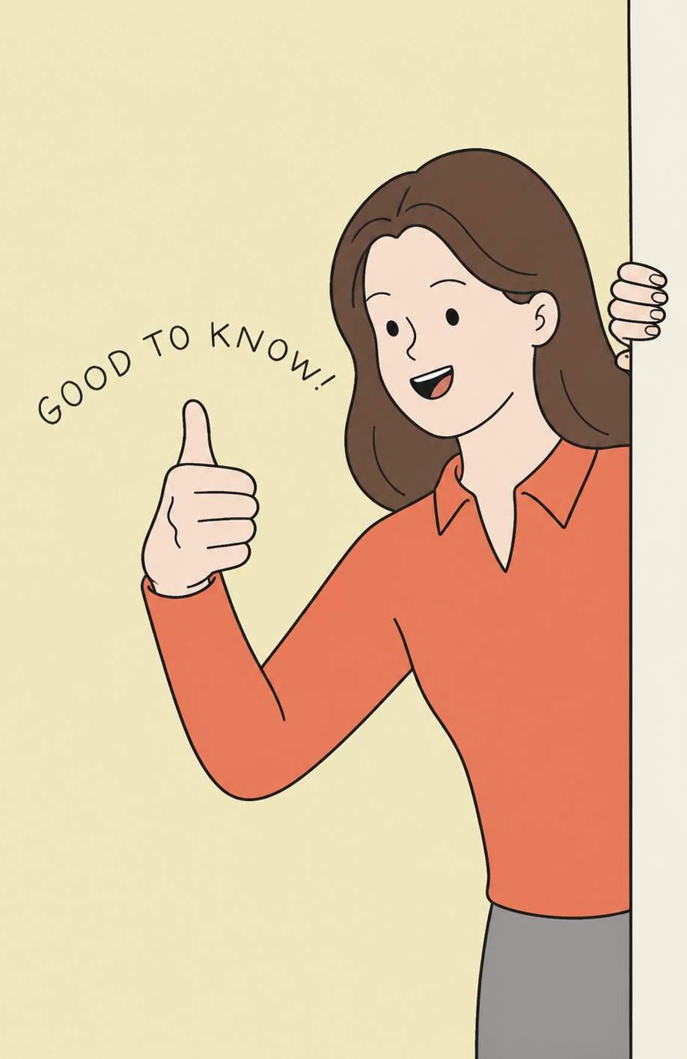
Testable Figures
None
All figures corresponding to the results of a study are testable material.

